Slide 1
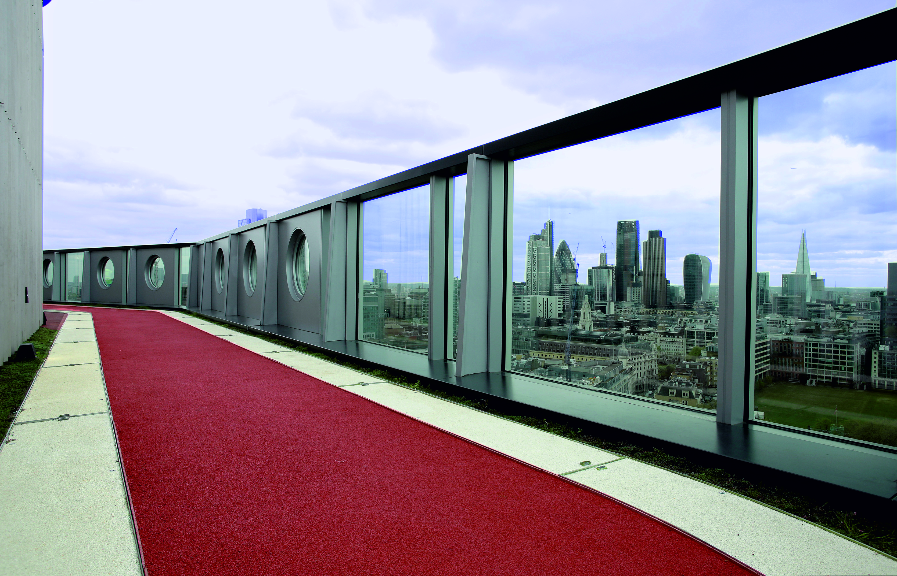

Slide 2
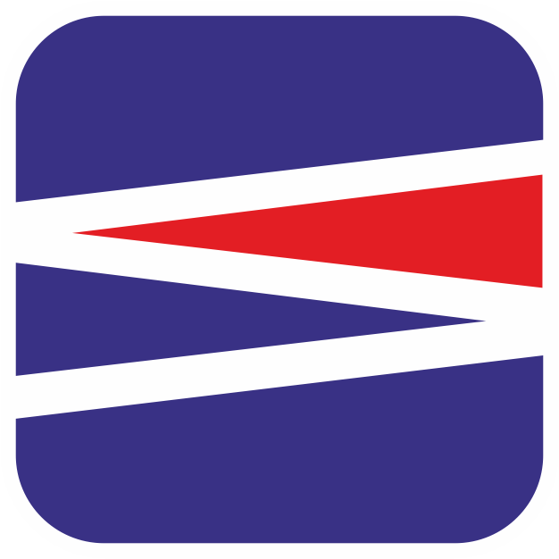
SEL Environmental - Background
Established in 1999.
Current turnover in the order of £4,000,000
Over 30 employees
6 strategic divisions
National and International coverage
40,000 sq. ft. premises based in Blackburn
Highly skilled fabrication workshop
Very experience installation teams
Notes:
Talk through the bullet points

Slide 3
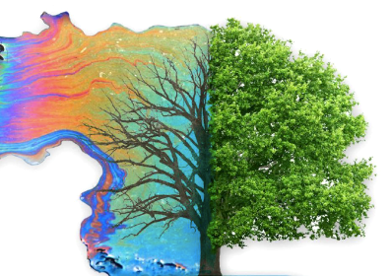
SEL Environmental - Our Service
Our all-encompassing service includes:
Design Assistance and Value Engineering
Project Management
Experienced Contracting
Precision Fabrication and Unique Product Ranges
Research and Development
Notes:
Sel Environmental values its clients and strives to always identify the most cost-effective solution possible for their needs especially at tender stage where our input could provide a competitive edge.
Sel Environmental will work closely and diligently with all parties to coordinate all aspects of a project to facilitate a successful completion.
Sel are Constructionline Gold accredited, have SSIP accreditation and ISO9001 certification.
Close collaboration with industry partners and academia also gives Sel the ability to influence, and the readiness to react to, forthcoming legislation and guidance.
Sel's fabrication team produces a robust range of construction products from hdpe, pp and steel for all aspects of drainage (in ground, podium and roof) and for gas protection.

Slide 4
SEL Environmental - Sectors
A diverse yet focussed company, operating in multiple sectors:
Commercial Integrated Water Management
Residential Source Control
Sports Facilities
Green Infrastructure
Building Protection Systems
Gas Migration
Notes:
Talk through the bullet points

Slide 5
Commercial Integrated Water Management
Value engineering
Experienced contracting and project management
Shallow attenuation/soakaway
Membrane and Geotextile procurement and installation.
At source hydrocarbon treatment
Flow control
Excel with challenging projects
Monitoring and control telemetry
Notes:
Sel Environmental focuses on applying the principles detailed in the CIRIA C753 "The SuDS Manual“
Innovative products and systems created by Sel can efficiently implement such principles, even in the most challenging circumstances.
Sel's solutions promote and enable seamless integration of permeable paving, green infrastructure, swales, wetlands and detention ponds.

Slide 6
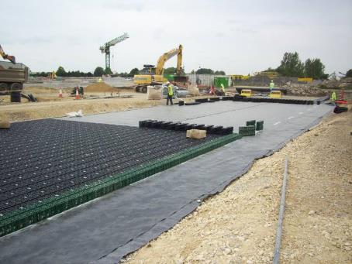
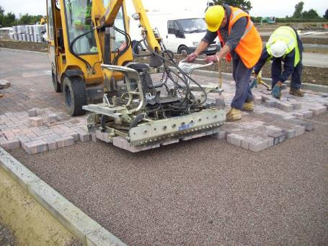
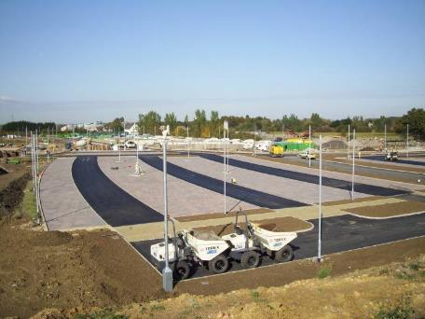
Commercial Integrated Water Management
Longstanton Park & Ride
Notes:
This project is Longstanton park and ride in Cambridgeshire. The image shows the installation of a shallow permavoid system below a permeable surface.
Sel installed the membranes and the permavoid but collaborated with the contractor ‘bardon’ at tender stage to develop a more cost-effective solution for the park and ride drainage.
Incidentally we recently assisted in the surface water drainage design for some of the housing developments at the nearby new Northstowe garden city.

Slide 7
Residential Source Control
Source control
Effective permeable paving
Attenuation/soakaway
Managing surface water within the boundaries of individual properties
Simplified design for enhanced efficiency
Standardised products
Flow control
Notes:
We have a wide range of our ‘home-grown’ products and solutions for residential developments, with a focus for managing water within plot boundaries.
Comprising flow control chambers, diffuser units for permeable pavements, impermeable membranes and geotextiles

Slide 8
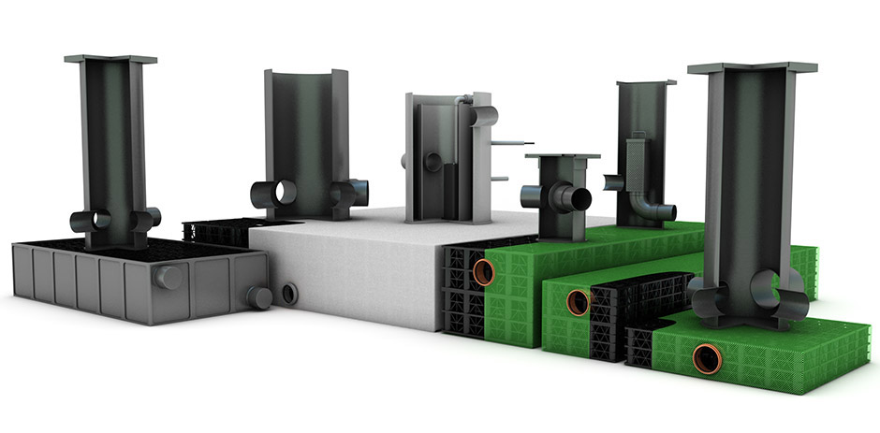
Residential Source Control
Notes:
The above image shows a few of our systems, going left to right:-
A skeletank module for attenuation, with a robust rotationally moulded shell, with an internal high strength structure.
Various silt chambers.
Various flow control chambers.
A raintaina attenuation module with an internal flow control, for ‘within-plot’ surface water management
Various diffuser units for the efficient inflow of rainwater into voided sub-base

Slide 9
Retrofit SuDS Systems
Retrofit SuDS can:-
Help solve localised flooding issues
Address water quality problems
Green-up urban areas
Attract new / Support ecosystems
Improve the living environment
SEL promote low disruption solutions & technologies
Notes:
Talk through the bullet points

Slide 10
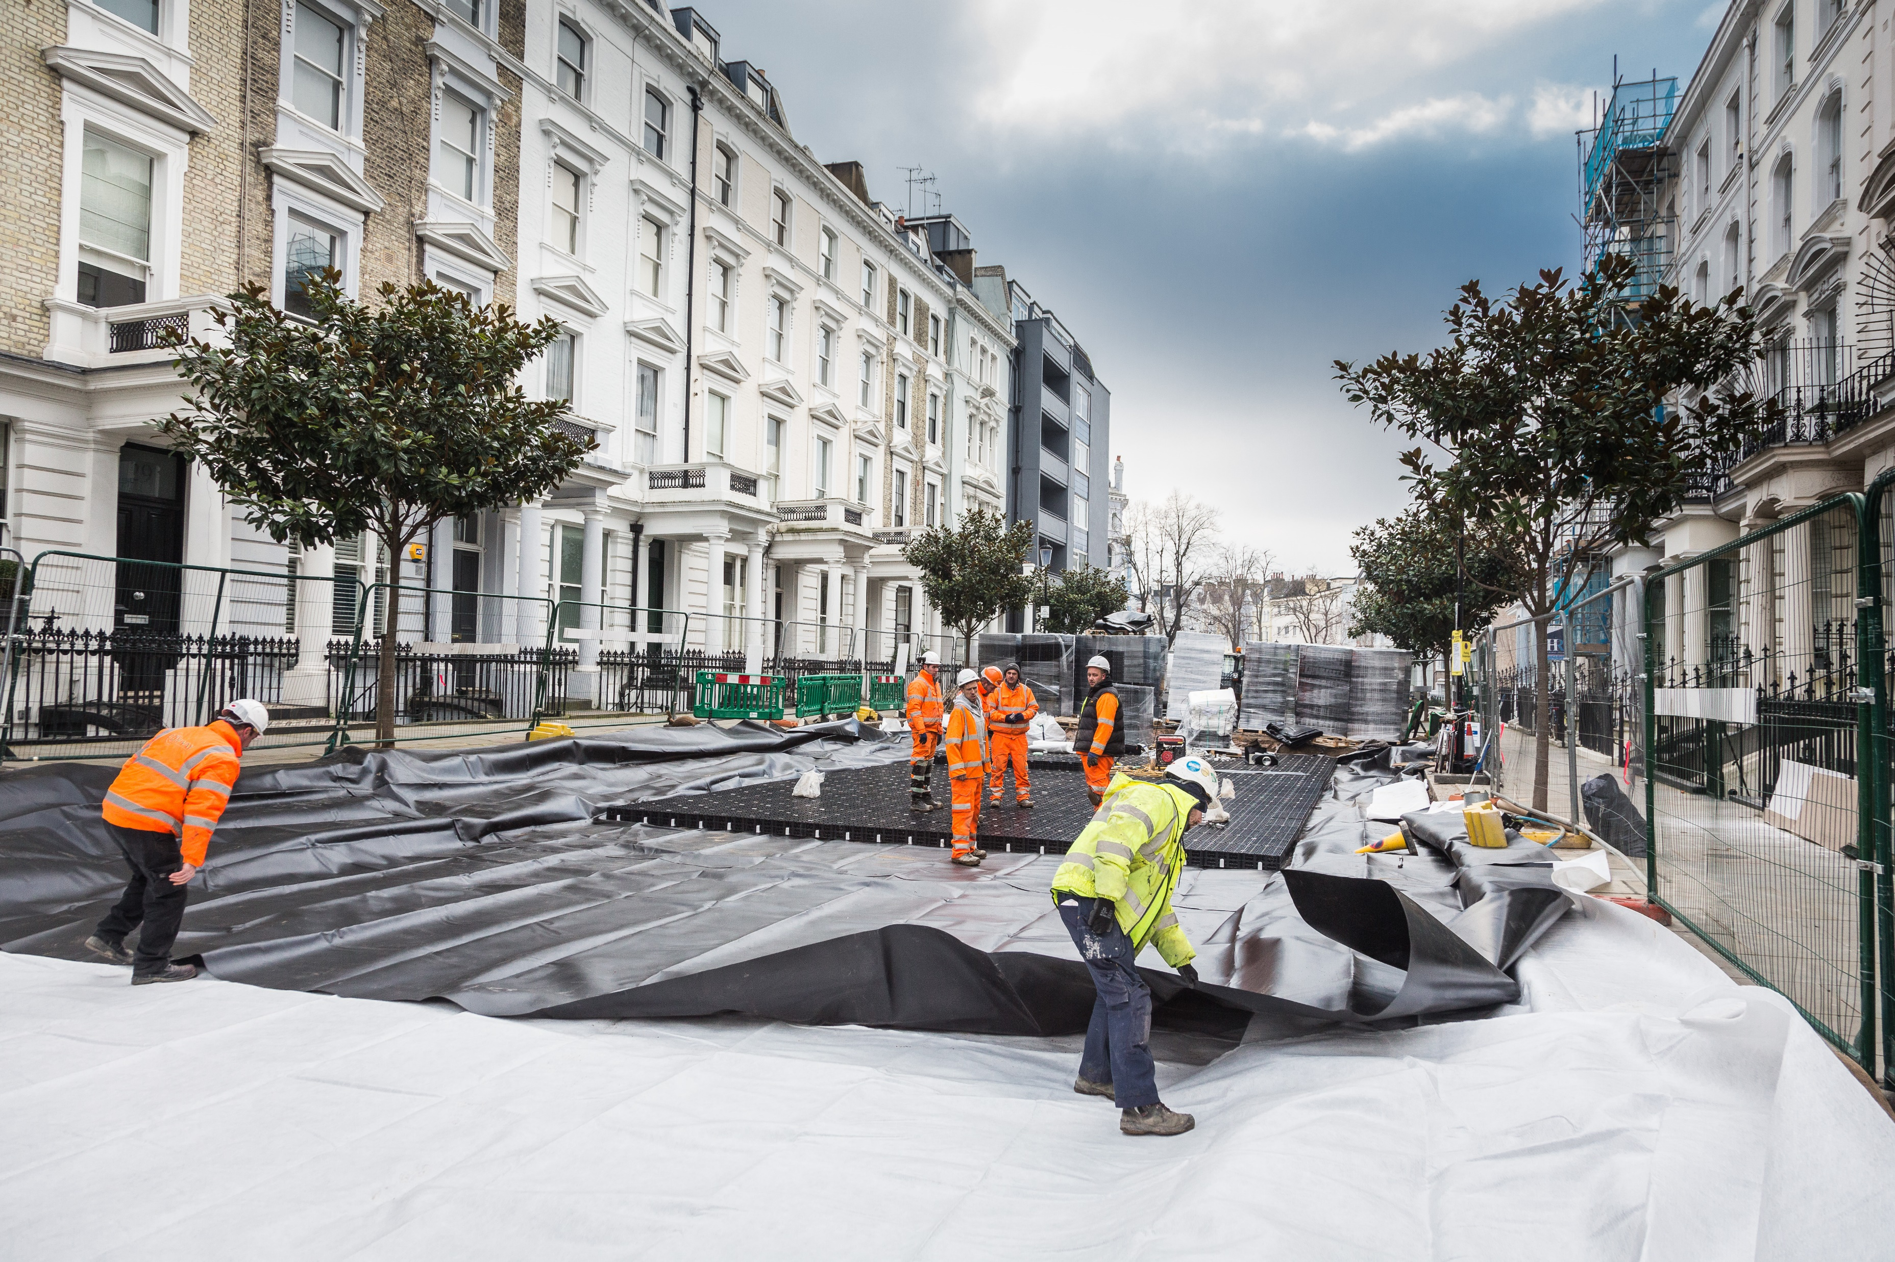
Retrofit SuDS Systems
Notes:
The image shows installation of a retrofit suds scheme in London known as Counter Creek Flood Alleviation Scheme aka Greenstreets.
The purpose of the suds system was to slow the flow of water into sewer during periods of rainfall to prevent the local sewer surcharging and flooding nearby basements.
At Arundel Gardens (image shown) the existing flow rates into sewer could be as much as 200 l/s during heavy storms. After the SuDS system was installed the flow into sewer was reduced to around 6l/s, a 97% reduction.
SEL worked very closely with the Consultants Atkins Global, Thames Water, the Royal Borough of Kensington and Chelsea and FM Conway to deliver this pioneering scheme.
This scheme won the Green Organisation’s, Green Apple Award for Sustainability in 2017

Slide 11
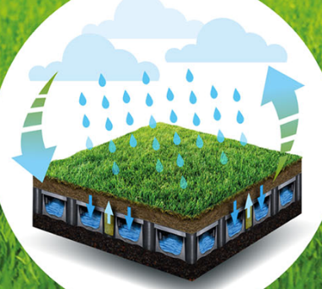
Sports Facilities
Turnkey Solutions
Unique lightweight construction – ideal for rooftops
Systems developed through in house R&D
Specialist contracting and project management
Impressive portfolio of high profile projects
Can be incorporated as part of a sustainable drainage system
Notes:
Talk through the bullet points

Slide 12
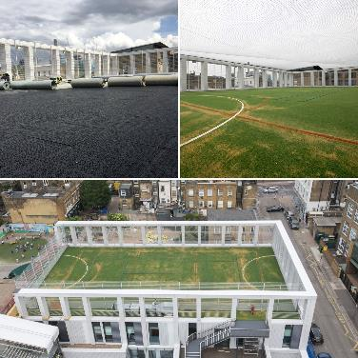
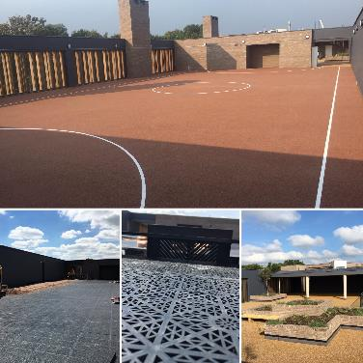
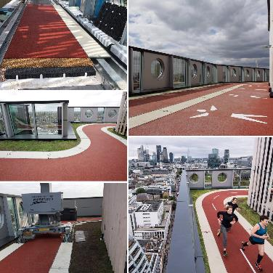
Rooftop Sports Facilities
Battersea Rooftop MUGA (artificial)
Putney Rooftop MUGA (resin bound gravel)
London’s First Rooftop Running Track
Notes:
The Battersea scheme was a new rooftop MUGA (multi use games area) for a new school.
The Putney scheme was a resin bound gravel playground with a separate socialising area with planting.
The running track was installed at level 16 at the White Collar Factory in London.
All these installations used an 85mm thick permavoid raft to provide a lightweight, very effective and efficient drainage layer.

Slide 13
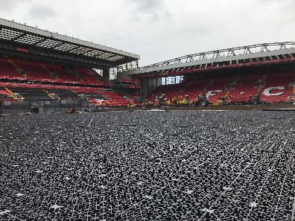
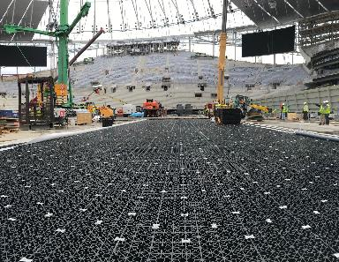
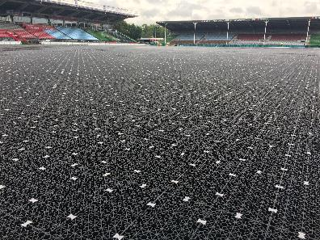
Ground Level Sports Facilities
Anfield, Liverpool
New White Hart Lane, Tottenham
Temporary Hockey Event, Twickenham
Notes:
Anfield – SEL installed a full permavoid raft below the grass pitch construction.
Tottenham – SEL installed a permavoid raft below the grass pitch which retracts below the stand in 3 sections. SEL also installed the permavoid drainage layer below the underlying synthetic NFL pitch below.
Twickenham – SEL installed the temporary breakthrough pitch system developed specifically to International Hockey Federation (FIH) standards for a series of FIH Pro League matches between Great Britain and New Zealand at the Twickenham Stoop stadium on 23 June 2019

Slide 14
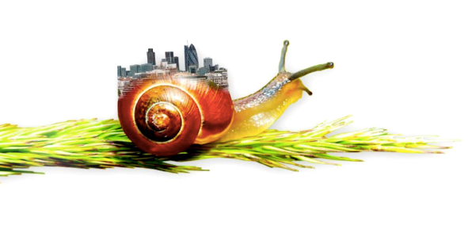
Green Infrastructure
Passive irrigation
Unique product range developed through in house R&D
Living Roofs
Soil moisture monitoring and control
Linear and Modular
Temporary or Permanent overlay solutions
Notes:
Talk through the bullet points

Slide 15
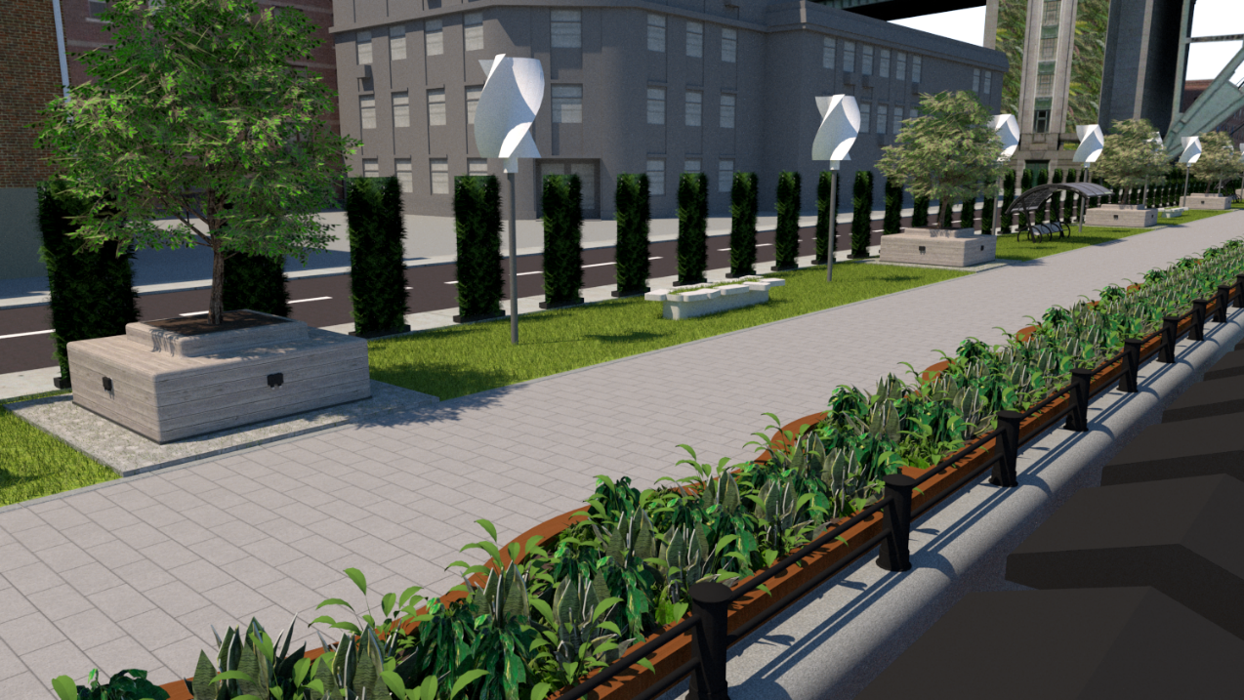
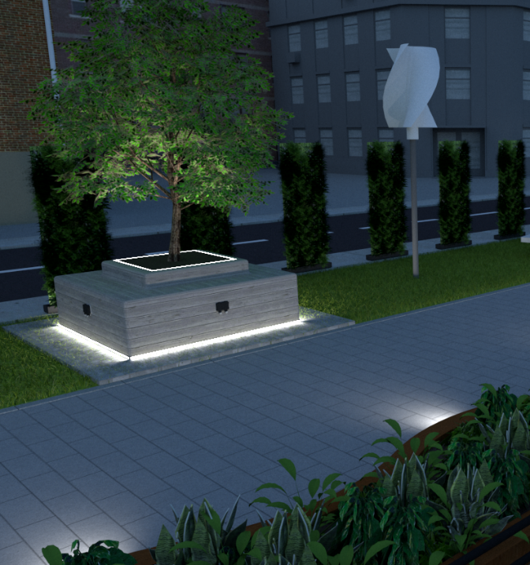
Green Infrastructure
Notes:
This are 2 images from Sel’s submission for the “Design of our Tyne” competition, which centred around retrofit green infrastructure technologies that could be utilised at the quayside in Newcastle near the Tyne bridge. Sel were joint winners with Fairhurst.

Slide 16
Building Protection Systems
Site Investigations
Damp proof/waterproofing to structures
Gas protection (hazardous gasses)
Installations in accordance with BS EN ISO 9001
National installation coverage with multiple installation teams
Notes:
Talk through the bullet points

Slide 17
Building Protection Systems
Notes:
The above images show (top row) a membrane liner to a permeable road (white), passive gas dispersal layer, green gas barrier membrane, hot air membrane sealing around a column penetration
(bottom row) 3 different gas protection installations.
Sel work with all the major gas system manufacturers such as Juta, Proctor, Visqueen and Cordek.

Slide 18
Lateral Gas Migration
Pathway Interception/preferential pathway
Virtual Curtain
No-dig solutions
Minimal disturbance of contaminated land
No dewatering
Rapid installation
Notes:
Talk through the bullet points

Slide 19
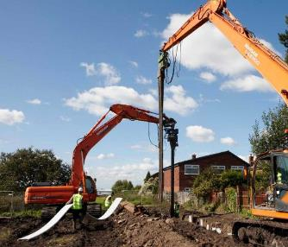
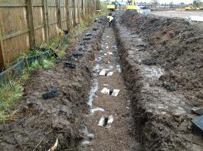
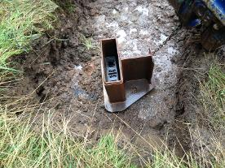
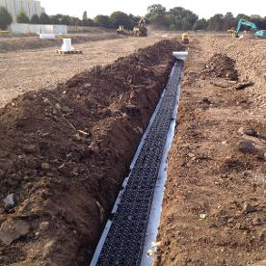
Lateral Gas Migration
Notes:
The images show the various stages of a vibro-installation, depths up to 10m are achievable.
The vibro-method is essentially a ‘no-dig’ installation, with soils from the upper shallow trench reinstated after installation.
For greater depths we can switch to a rotary auger method which utilises 300mm diameter wells.

Slide 20
What SEL Can Give You?
Competitive Edge
Design Assistance
Value Engineering
Project Management
Experienced Contracting
Quality Assurance
Precision Fabrication
Research & Development
Peace of Mind

